Slide 1

Des Moines Data Group
Prepared by Canny Li, Stephen Schmidt, Munju Kam, Josh Hjelmaas

Slide 2

Introduction

Slide 3

Project Background
Des Moines Data & Analytics Group is an organization focused on connecting the data and analytics community in Des Moines area
Focus on analysis of overall membership trend, membership characteristics and event attendance data

Slide 4
Project Milestone
Data Cleaning
Descriptive Analysis
Clustering Analysis
Predictive Model
Data Visualization & Dashboard

Slide 5
Data Summary
Total Members: 1,665
Number of Events: 41
Average Attendance for Events: 69

Slide 6

Data Cleaning

Slide 7
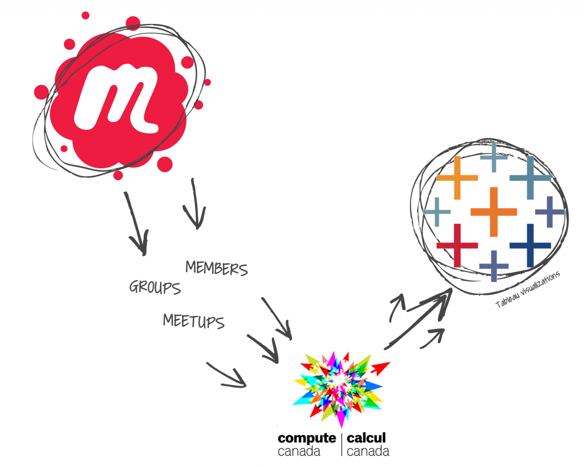
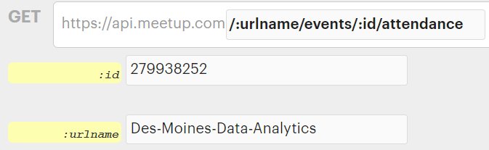
Meetup API
This Photo by Unknown author is licensed under CC BY.
Notes:
We use the Meetup API to collect the attendance data. We will provide the group name and event ID to get the attendees info.
What API provides is actually the RSVP info. It will get back a list of members who responses the notification.
Therefore, we merge the data from API with original data only if the member info in original data is lacked.

Slide 8
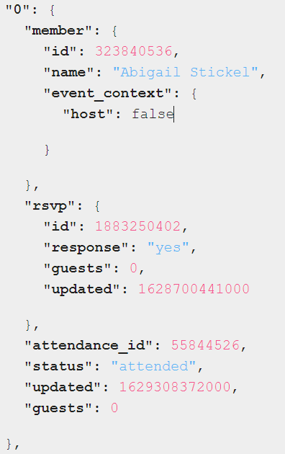
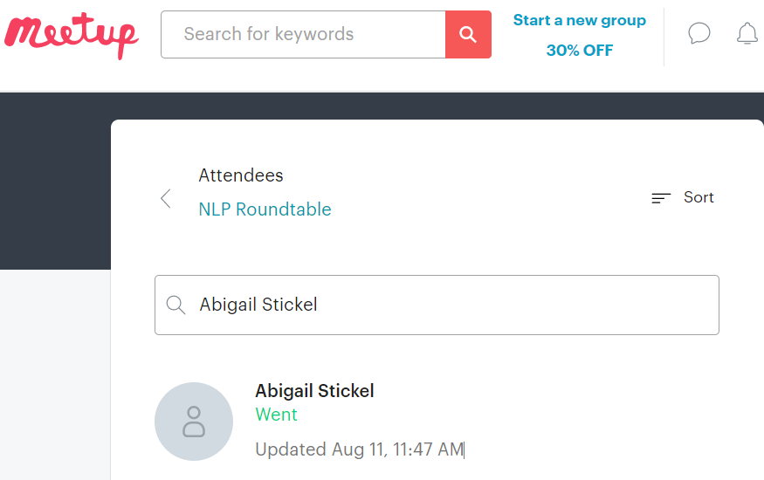
Notes:
Response
Member info
RSVP info
Attendance info
Webpage: https://www.meetup.com/Des-Moines-Data-Analytics/events/279938252/attendees/
API page: https://secure.meetup.com/meetup_api/console/?path=/:urlname/events/:id/attendance
The API will get a list of members who response to the invitation (both accept or decline).
Unfortunately, it sometimes does not include the attendance info. In order to correct the lack of data, I create a quick VBA code to help myself. But the VBA code is created for one time use, and the result is not repeatable.
I am pretty sure that most of the attendance info are matched with the one on Meetup webpage

Slide 9
Cleaned Dataset
Member
Member ID
member.photo
member.bio
member.Looking
member.jobCategorization
event.organizer
Response
rsvp.updatedHour
rsvp.Toevent
rsvp.response
AttendStatus
Event
Event ID
Company
Event type
EventWeekDay
EventTimeofDay
City Grouping
*Highlighted features are from scraped data
Notes:
For this "final" dataset, we merge and join the given dataset. It is included in our final delivery, named as "
Event
We only added the weekday of event using excel formula.
Member
As the API data can also provides the info whether a member has photo and biography, we update it into the member workbook if the original member workbook does not contain.
Response
rsvp.updatedHour is from the rsvp.updated. We got the hour (0-23) from that updated datetime, which represents the hour of rsvp time.
rsvp.Toevent is calculated by event date substruct rsvp updated date. If a member response on Nov 2, and event date is on Nov 5. Then the value of rsvp.Toevent is 3.
rsvp.response is copied directly from API data. The value is yes/no.
AttendStatus is cleaned manually and only has two value ("Went" and "Didn't Go").

Slide 10
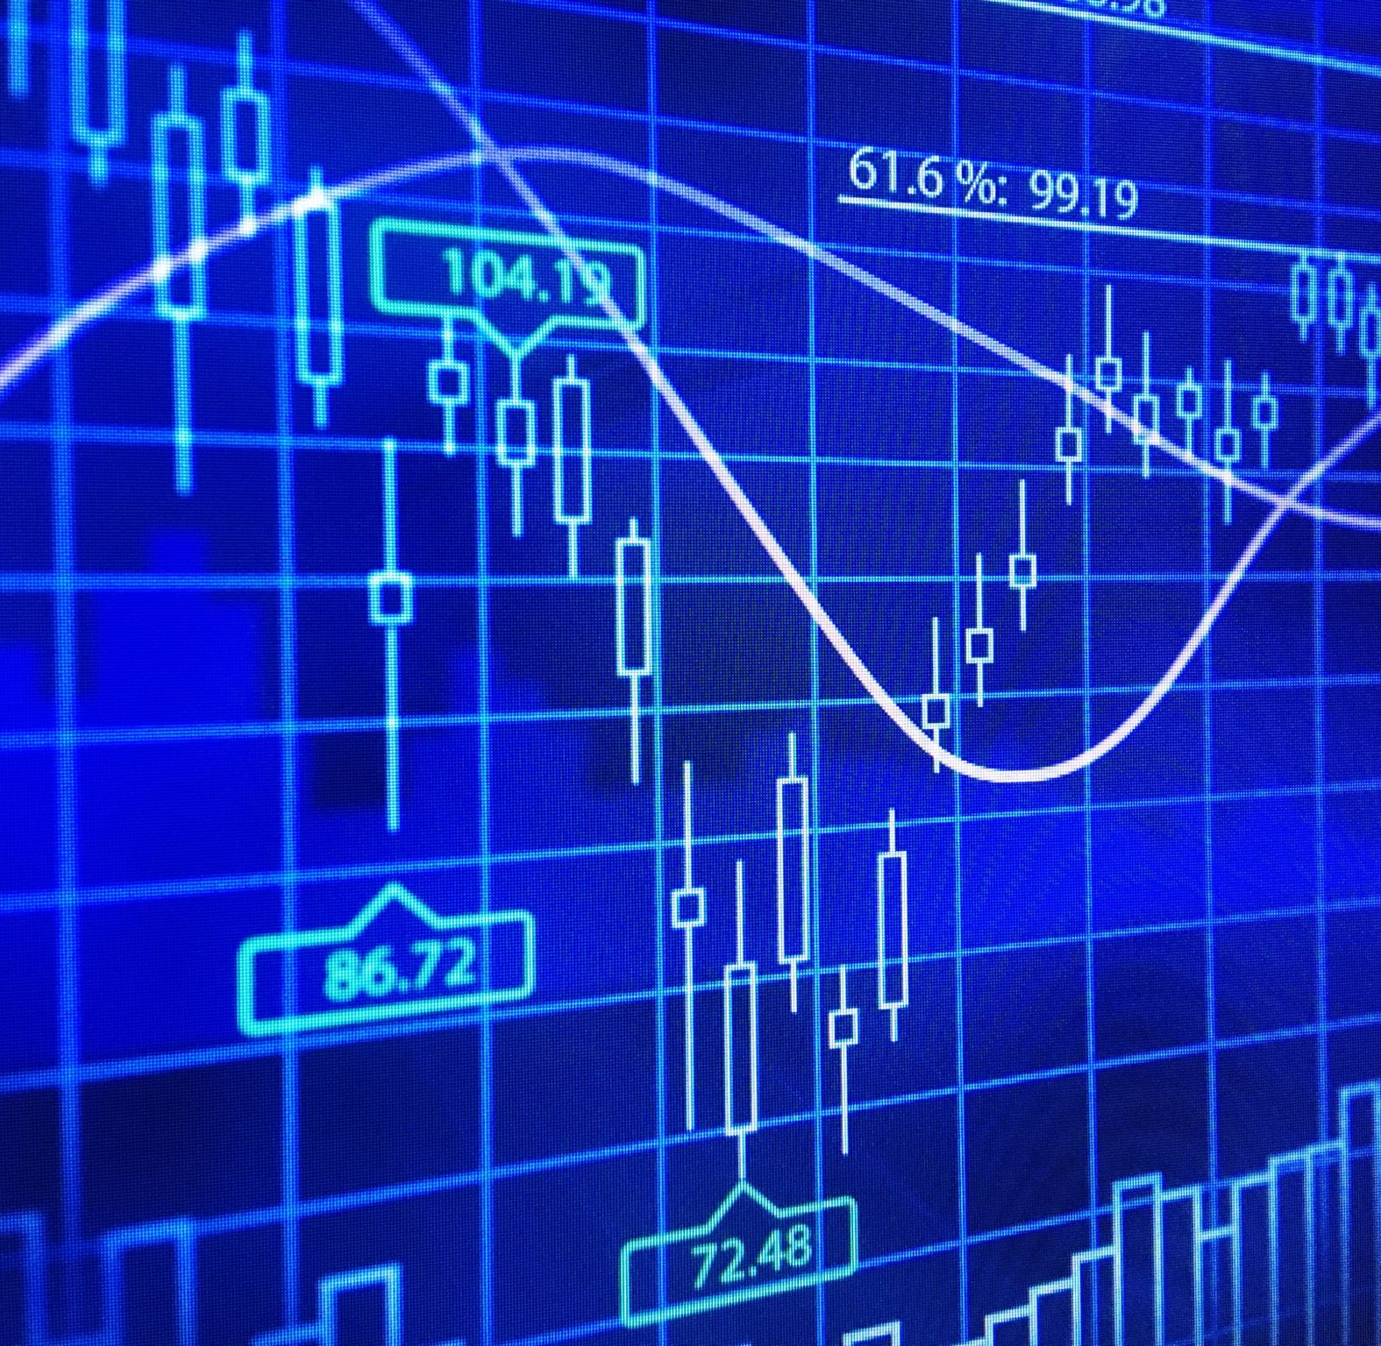
Descriptive analysis

Slide 11
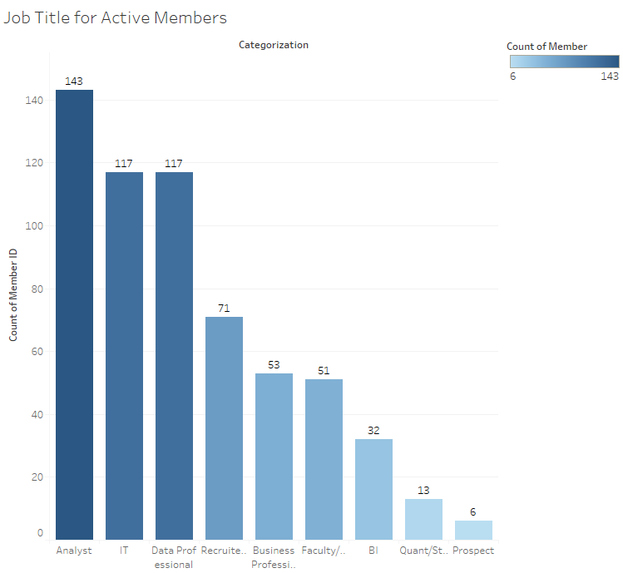
Job title for Active Members -Analyst -IT -Data Professional

Slide 12
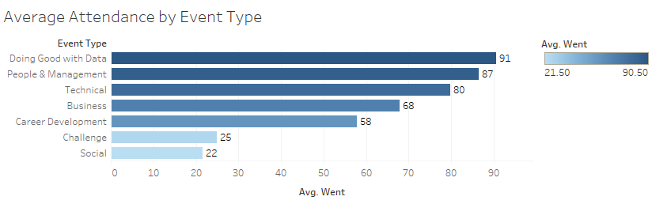
Popular Event Type Most popular events -Doing good with data -People & Management -Technical

Slide 13
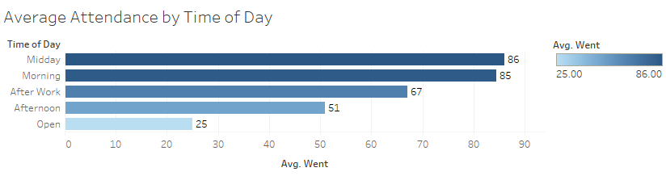
Popular Time of day for Meeting Most popular meeting time -Midday -Morning

Slide 14
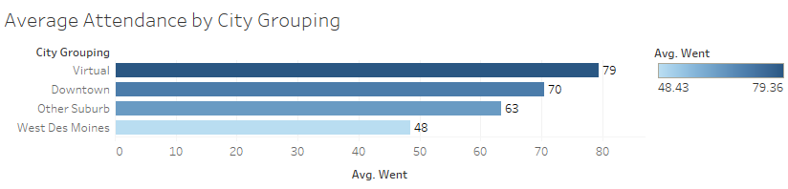
Popular meeting location -Virtual -Downtown -Other Suburb

Slide 15
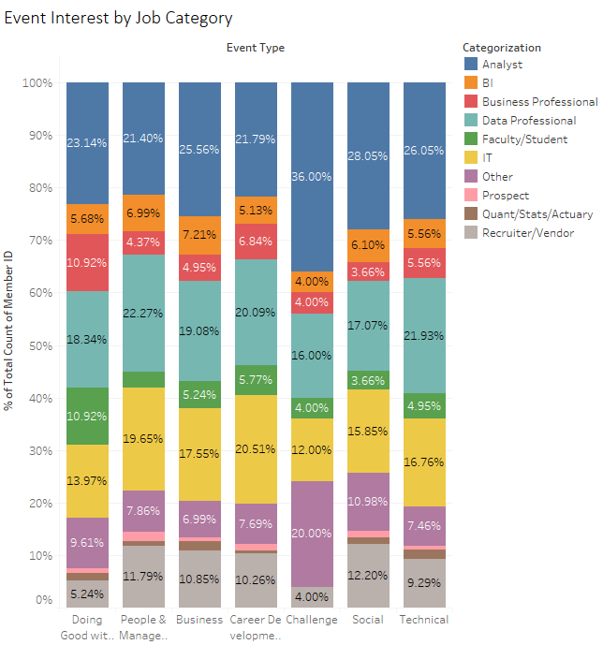
Event Interest by Job Category

Slide 16
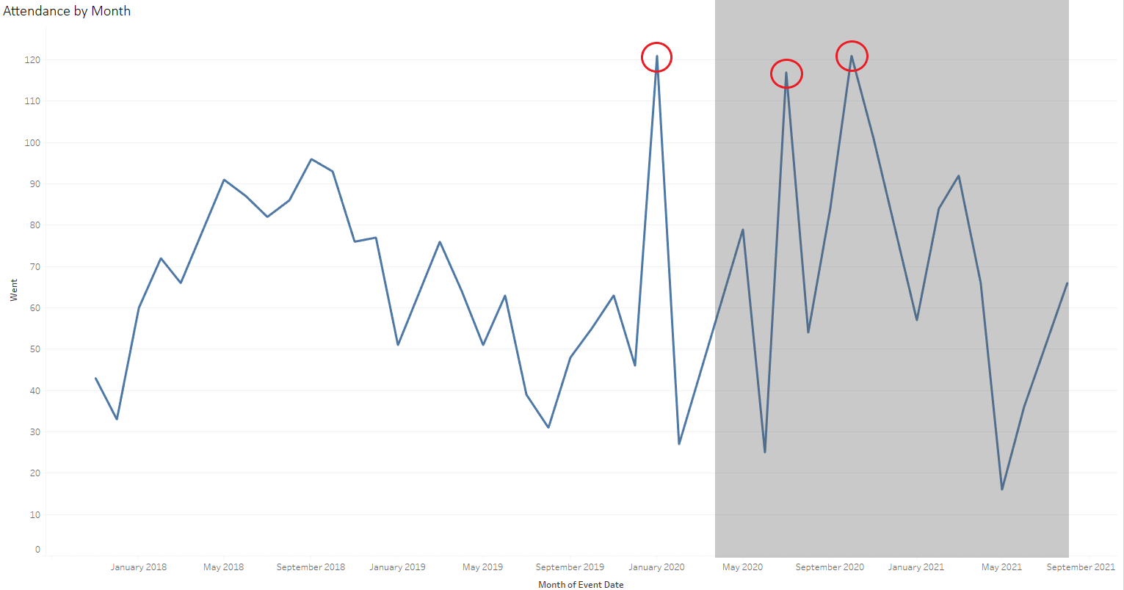
Attendance by Month Highest Attendance: -January 2020 Developing Self-service Dashboard (Technical) -October 2020 Ensembles: Making Elegant Models Together (Technical) -July 2020
Doing Good with Data in Des Moines (Doing Good with Data)

Slide 17
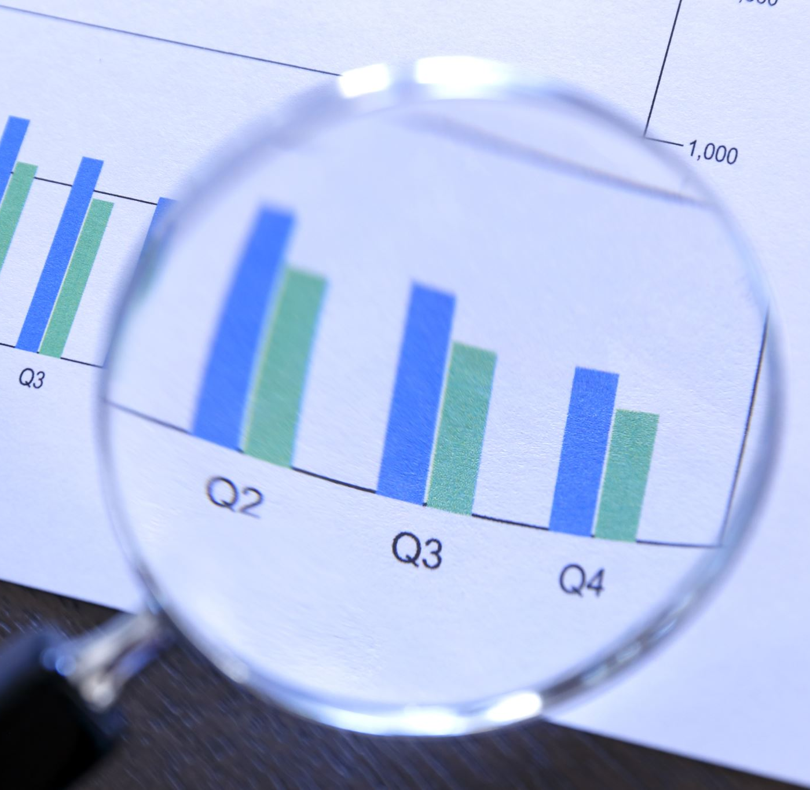
Clustering Analysis & Predictive Model

Slide 18
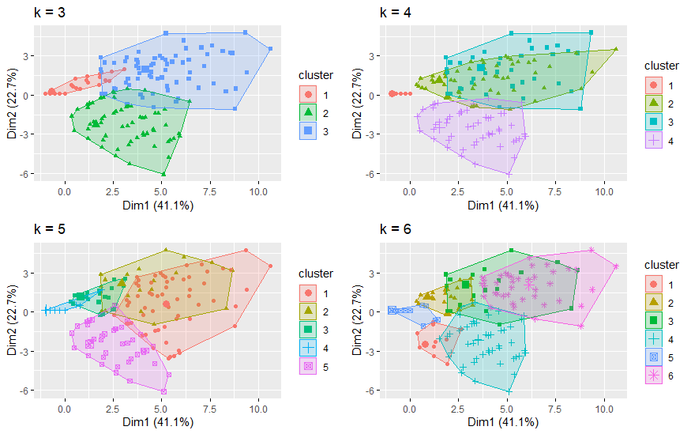
Clustering Analysis for Members
Ran k-means cluster analysis from k=2 to k=20 for DSM Data Members.
Examples of 2-D rendering of clusters k=3 to k=6.

Slide 19
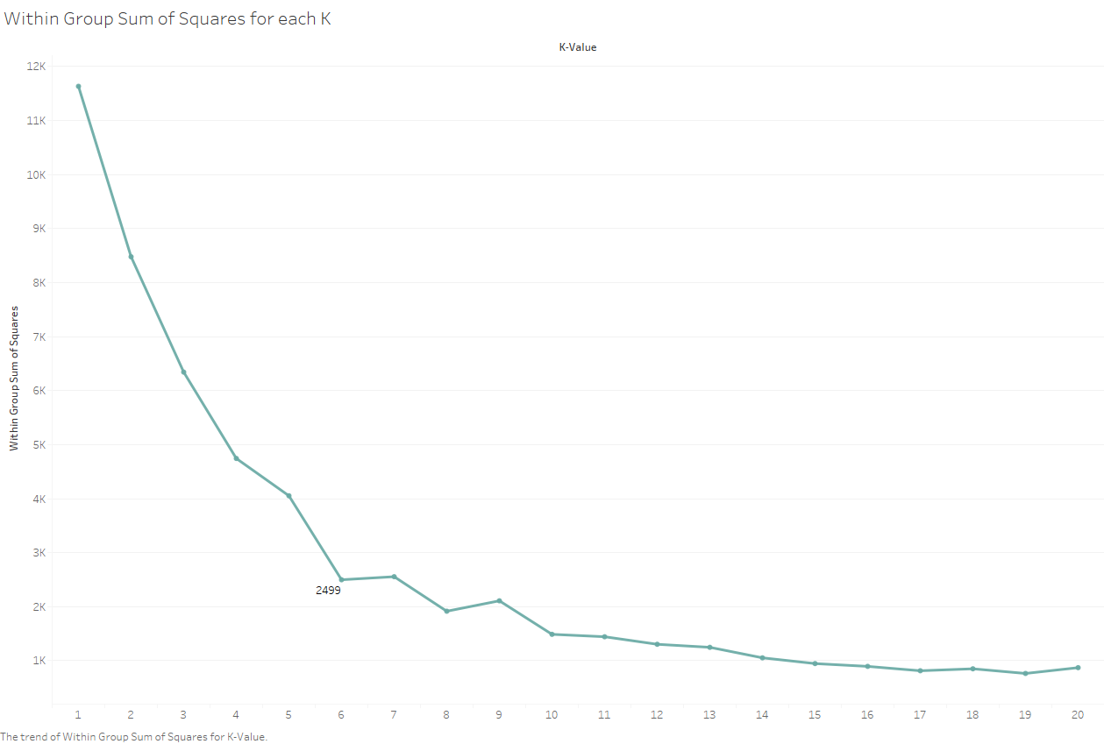
Clustering Analysis for Members (cont.)
Typically look for ‘inflection point’ when deciding on clusters—where is WGSS minimized before returns noticeably diminish?
Optimal cluster number appears to be 6.
K = 6 also had highest silhouette score of 0.8184

Slide 20
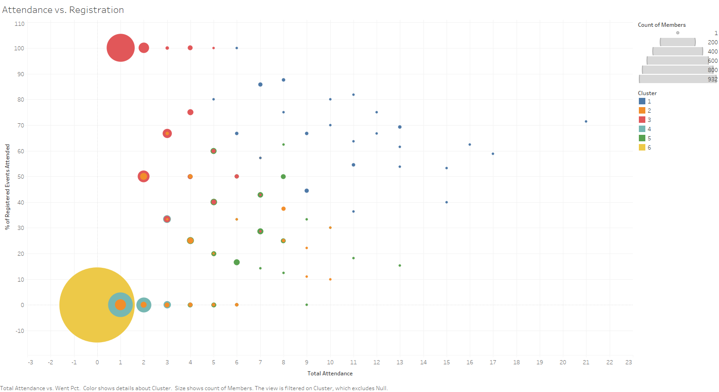

Slide 21





Cluster Characteristics
1. Superstars
2.04% of total, went to 10.44 events, 66.67% attendance of registered events
2. Below Average
4.14% of total, went to 3.41 events, 17.58% attendance of registered events
3. Reliable but Infrequent
13.15% of total, went to 1.88 events, 85.82% attendance of registered events
4. Surprise Guests
10.39% of total, went to 1.57 events, 5.97% attendance of registered events
5. Above Average
4.74% of total, went to 6.11 events, 30.40% attendance of registered events
6. Ghosts
65.41% of total, went to 0.19 events, 0.12% attendance of registered events
Notes:
Percentage of total, Avg. Attendance, Avg. Went Pct:
2.04%, 10.44, 66.67%
4.14%, 3.41, 17.58%
13.15%, 1.88, 85.82%
10.39%, 1.57, 5.97%
4.74%, 6.11, 30.40%
65.41%, 0.19, 0.12%

Slide 22
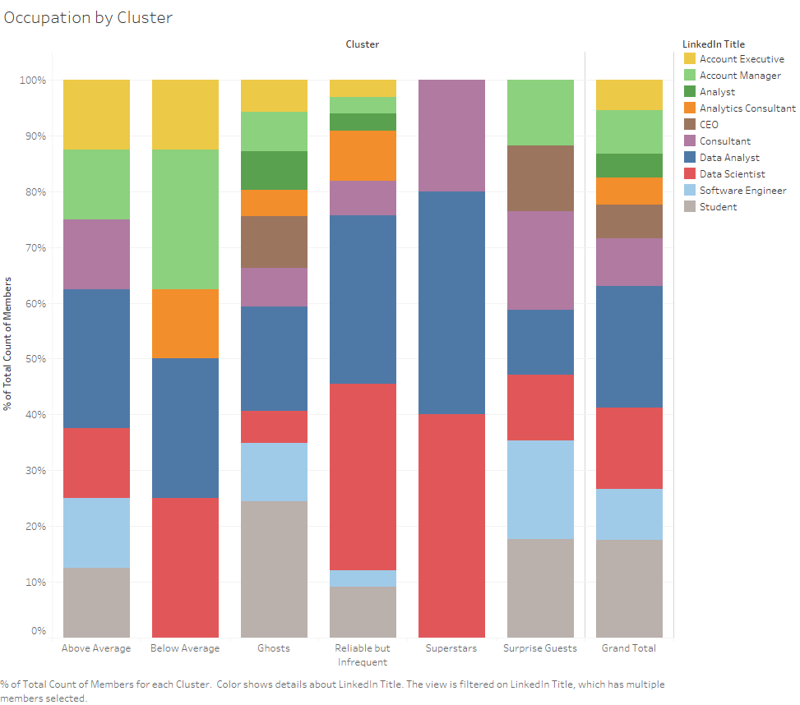

Slide 23
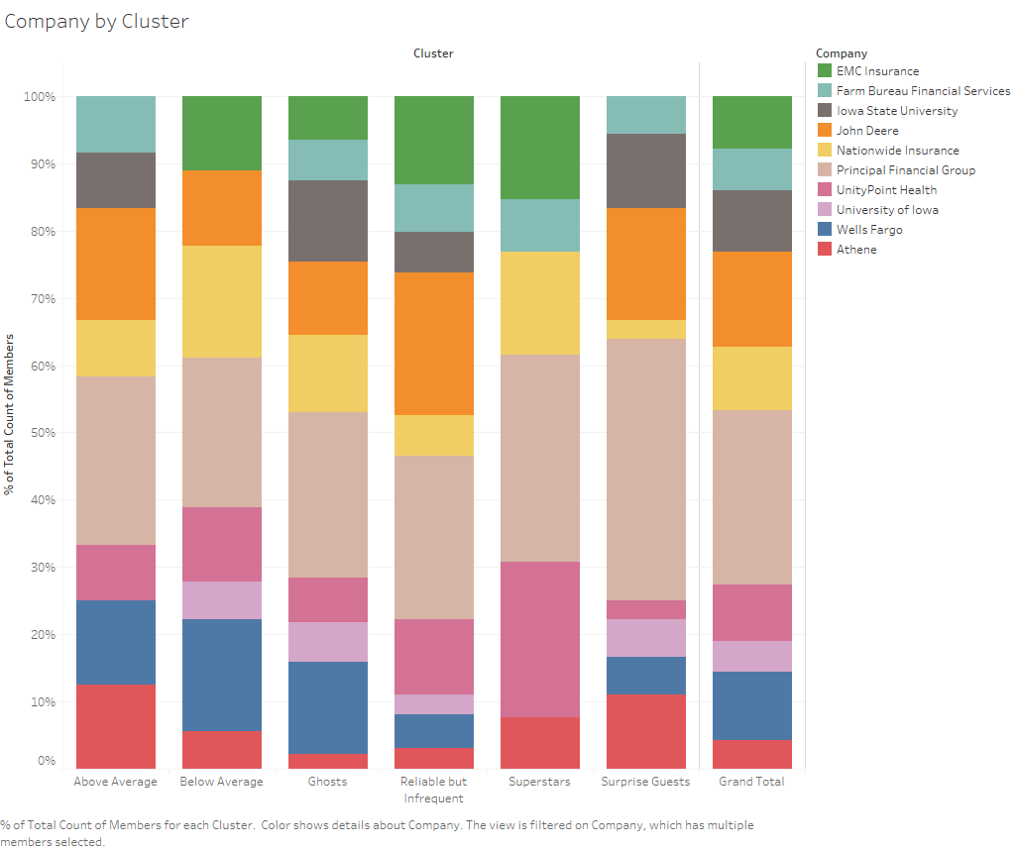

Slide 24
Predictive Model
Attendance (went/didn’t go) as target
Classification models
Logistic Regression​
K-Nearest Neighbors​
Random Forest​
Support Vector Machine​
Decision Tree

Slide 25
Classification Tree
Company=BG,Django,DMARC,EMC,BF,IC,INTL FC Stone,JDF,Microsoft,Mom's Meals,Prin.F,UnityPoint
EventTimeofDay=After Work,Afternoon,Morning
event.organizer=yes [AttendStatus=Went cover=58 (3%) prob=0.88]
event.organizer=no
……
member.jobCategorization=Other [AttendStatus=Didn't Go cover=85 (4%) prob=0.24]
EventTimeofDay=Midday
rsvp.response=yes [AttendStatus=Went cover=257 (12%) prob=0.81]
rsvp.response=no [AttendStatus=Didn't Go cover=9 (0%) prob=0.00]
Company=Des Moines,DSM,Hy-Vee,Kum & Go,Nationwide Insurance,Panel [AttendStatus=Went cover=610 (27%) prob=0.83]
Notes:
Here is an example of one easy way to predict whether one will attend the event.
Company=Breakout Groups,Django,DMARC,EMC Insurance,Farm Bureau Financial,Individual Consultant,INTL FC Stone,John Deere Financial,Microsoft,Mom's Meals,Principal Financial,UnityPoint Health
EventTimeofDay=After Work,Afternoon,Morning
event.organizer=yes [AttendStatus=Went cover=58 (3%) prob=0.88]
event.organizer=no
member.jobCategorization=Analyst,BI,Business Professional,Data Professional,Faculty/Student,IT,Prospect,Quant/Stats/Actuary,Recruiter/Vendor
Event.type=Workshops,Workshops/Socialize
Company=INTL FC Stone,John Deere Financial [AttendStatus=Went cover=131 (6%) prob=0.79]
Company=Breakout Groups,Individual Consultant
TNM_EventWeekDay< 4.5 [AttendStatus=Went cover=61 (3%) prob=0.74]
TNM_EventWeekDay>=4.5 [AttendStatus=Didn't Go cover=100 (4%) prob=0.44]
Event.type=Guest speaker
rsvp.response=no
Allison.s.Event.Type=People & Management,Technical
EventTimeofDay=After Work [AttendStatus=Went cover=76 (3%) prob=0.89]
EventTimeofDay=Afternoon,Morning [AttendStatus=Didn't Go cover=31 (1%) prob=0.00]
Allison.s.Event.Type=Business,Career Development,Doing Good with Data,Social [AttendStatus=Didn't Go cover=121 (5%) prob=0.00]
rsvp.response=waitlist,yes
member.jobCategorization=Analyst,BI,Business Professional, Data Professional,Faculty/Student,Prospect, Quant/Stats/Actuary [AttendStatus=Went cover=479 (21%) prob=0.60]
member.jobCategorization=IT,Recruiter/Vendor [AttendStatus=Didn't Go cover=214 (10%) prob=0.43]
member.jobCategorization=Other [AttendStatus=Didn't Go cover=85 (4%) prob=0.24]
EventTimeofDay=Midday
rsvp.response=yes [AttendStatus=Went cover=257 (12%) prob=0.81]
rsvp.response=no [AttendStatus=Didn't Go cover=9 (0%) prob=0.00]
Company=Des Moines,DSM,Hy-Vee,Kum & Go,Nationwide Insurance,Panel [AttendStatus=Went cover=610 (27%) prob=0.83]

Slide 26
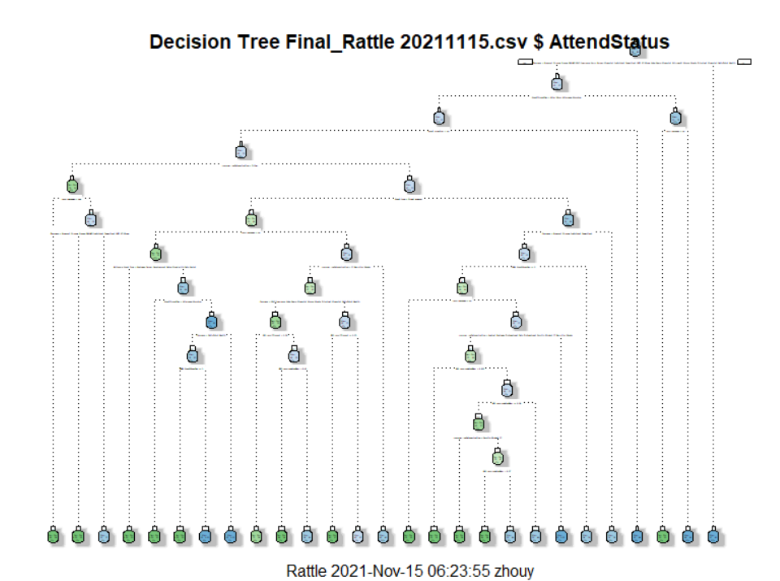
Decision Tree
23 groups with various attendance rate

Slide 27
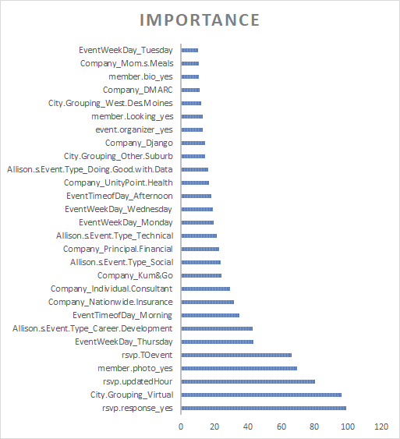
Important Features
Whether member responses
Whether event is virtual
Time of response
Whether member has photo
Day between event and response
Notes:
These are the importance for each factors in the model.
We can observe that 1) whether the meeting is virtual, 2) time of response, 3) whether event having guest speaker, and 4) the response date, are most important features.

Slide 28
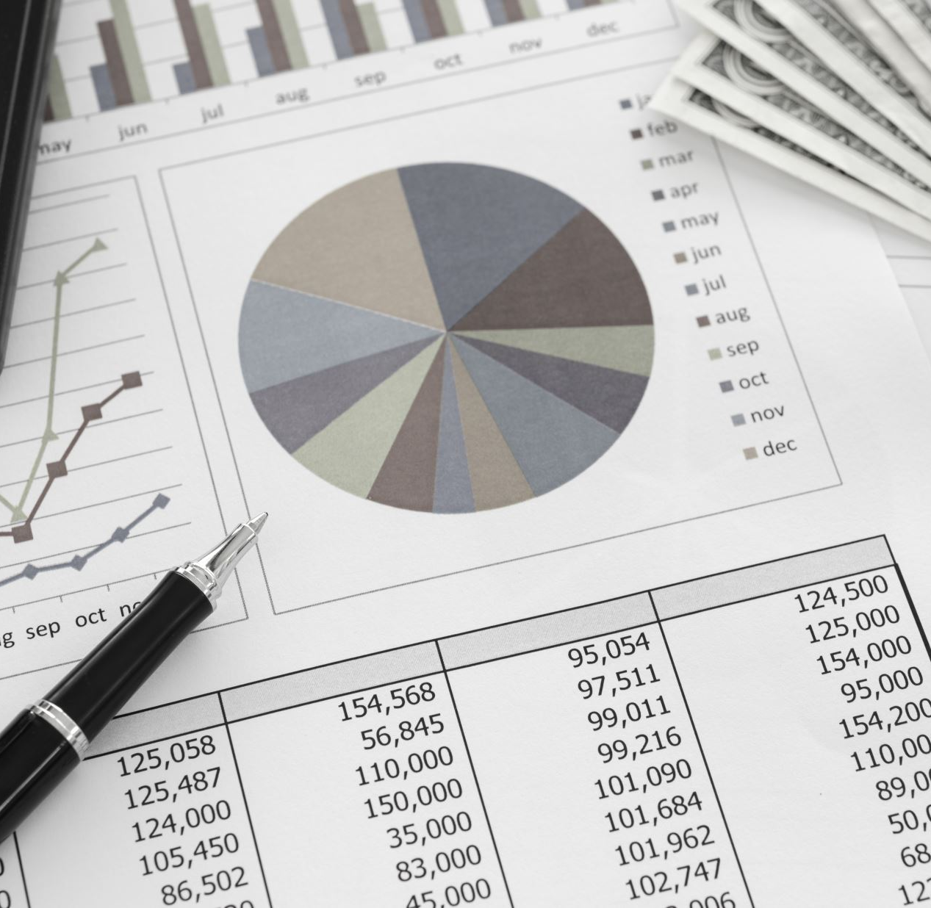
Data Visualization

Slide 29
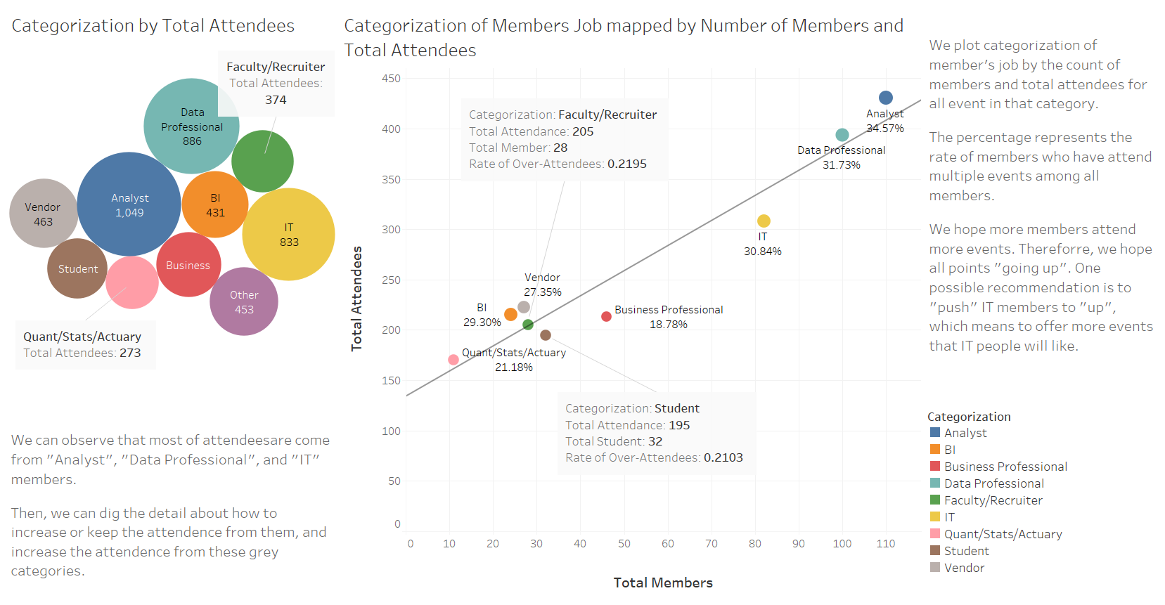

Slide 31
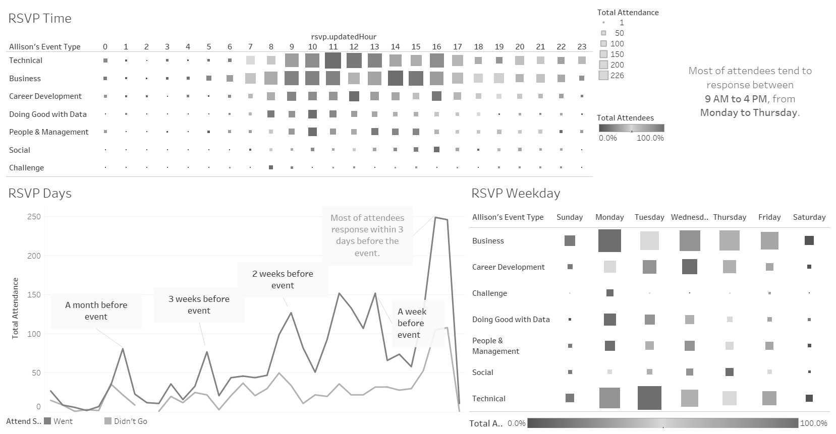
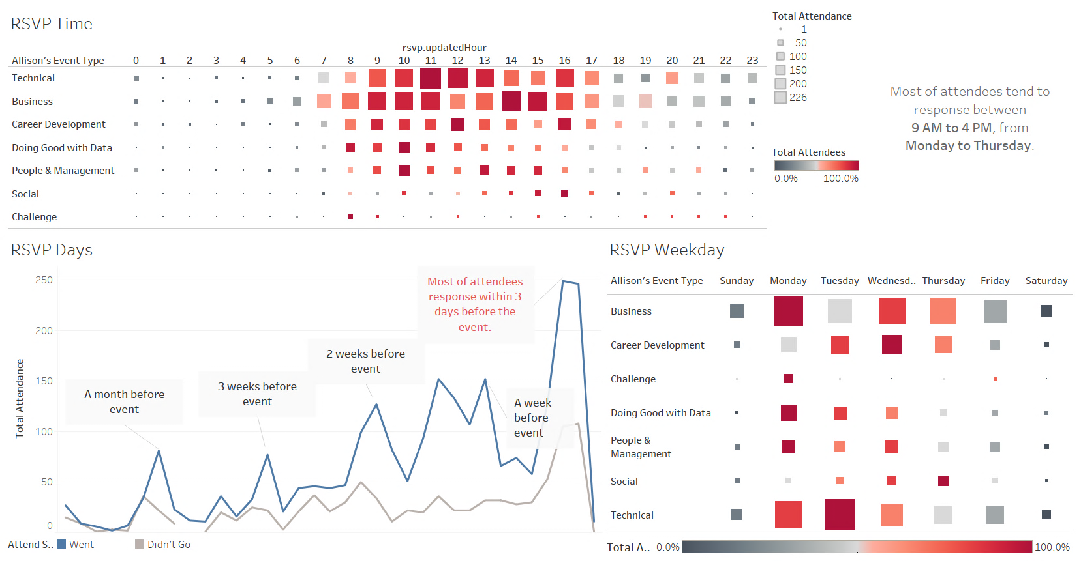

Slide 34

RStudio Shiny

Slide 35
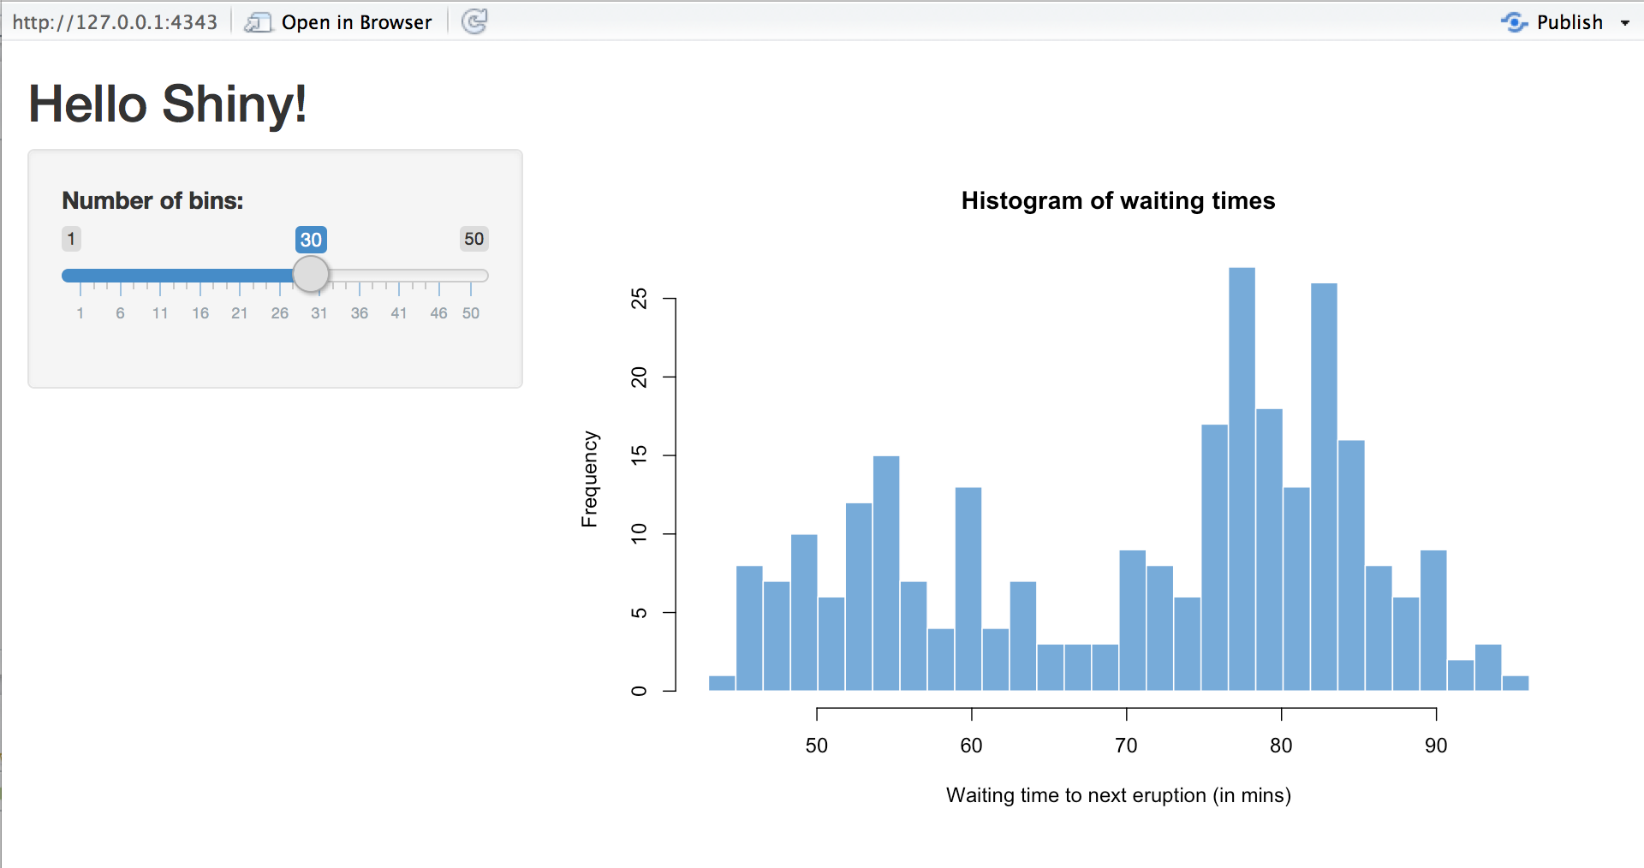
R Shiny
Open-source platform for dashboard development
User interface and visualizations created using R coding language.

Slide 36
Pros & Cons of R Shiny
Pros
Open Source
Can use R packages to create many visualization types
Cons
R Shiny syntax can be tricky (learning curve)
Limited interactive capabilities compared to other visualization software such as Tableau or PowerBI

Slide 37
Live Demo

Slide 38

Key Takeaways

Slide 39
Key Takeaways
Vast majority of members are disengaged
Students, executives among least reliable
Most engaged members are data analysts and scientists, especially in insurance sector
Members tend to prefer attending virtual events
Members who respond a week before the event are more likely to attend events.

Slide 40
Thank you for Listening! Questions?

